Slide 1
Classes-II
Said Nabi

Slide 2
Constructors
Member function that is automatically called when an object is created
Purpose is to construct an object
Constructor function name is class name
Has no return type
A class can have multiple constructors
Object Oriented Programming-Spring 23

Slide 3
Constructors
class Demo{
public:
Demo(){ //inline function
// Constructor
cout << "Welcome to the constructor!\n";
}
};
Object Oriented Programming-Spring 23

Slide 4
Constructors
class Demo{
public:
Demo(); // Constructor
};
Demo::Demo() //out-of-line
{
cout << "Welcome to the constructor!\n";
}
Object Oriented Programming-Spring 23

Slide 5
Constructors
Whenever an instance of a class is created, the constructor is automatically called
  Demo dem; //object dem is created
  //Prints
  Welcome to the constructor
Object Oriented Programming-Spring 23

Slide 6
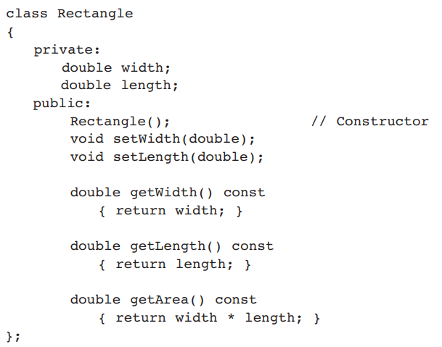
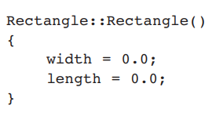
Constructors
Object Oriented Programming-Spring 23

Slide 7
What Constructors Do
Help in initializing class data members
  Employee( ) { id = 0; }
Allocate memory for dynamic members
  Employee() {
  char* nameptr = new char[20];
  }
Allocate any needed resources
  Such as to open files, etc
Object Oriented Programming-Spring 23

Slide 8
Default Constructors
A class can have only one default constructor
A default constructor is a constructor that takes no arguments
If you write a class with no constructor at all, C++ will write a default constructor for you, one that does nothing.
A simple instantiation of a class (with no arguments) calls the default constructor:
  Rectangle r;
Object Oriented Programming-Spring 23

Slide 9
Parametrized Constructors
To create a constructor that takes arguments:
  indicate parameters in prototype:
Rectangle(double, double);
  Use parameters in the definition:
Rectangle::Rectangle(double w, double len)
{
width = w;
length = len;
}
Object Oriented Programming-Spring 23

Slide 10
Parametrized Constructors
You can pass arguments to the constructor when you create an object:
  Rectangle r(10.7, 5.2);
Constructors can be overloaded
Rectangle(double w, double len, double ar){
width = w;
length = len;
area = ar;
}
Rectangle r(10.0, 5.0, 50.0);
Object Oriented Programming-Spring 23

Slide 11
More About Default Constructors
If all of a constructor's parameters have default arguments, then it is a default constructor. For example:
Rectangle(double len = 0, double wid = 0){
length = len; width = wid;
}
Creating an object and passing no arguments will cause this constructor to execute:
Rectangle r;
Cannot create multiple default constructors - ERROR
Object Oriented Programming-Spring 23

Slide 12
More About Default Constructors
Rectangle(double len = 0, double wid = 0){
length = len; width = wid;
}
Creating an object and passing no arguments will cause this constructor to execute:
Rectangle r;
Rectangle r1(10.0);
Rectangle r2(10.0, 2.0);
All three cause the same constructor to execute
With this constructor, cannot create any other constructor with 0,1 or 2 parameters.
Because then the compiler cannot differentiate and decide which one to call
Object Oriented Programming-Spring 23

Slide 13
Classes with No Default Constructor
When all of a class's constructors require arguments, then the class has NO default constructor.
When this is the case, you must pass the required arguments to the constructor when creating an object.
Object Oriented Programming-Spring 23

Slide 14
Destructors
Member function automatically called when an object is destroyed
Destructor name is ~classname, e.g., ~Rectangle
Has no return type; takes no arguments
Only one destructor per class, i.e., it cannot be overloaded
If constructor allocates dynamic memory, destructor should release it
Object Oriented Programming-Spring 23

Slide 15
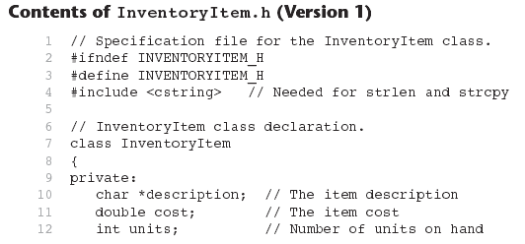
Example InventoryItem.h
Object Oriented Programming-Spring 23

Slide 16
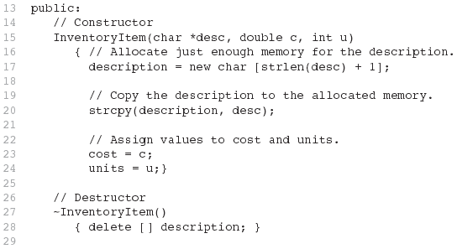
Example InventoryItem.h
Object Oriented Programming-Spring 23

Slide 17
Constructors, Destructors, and Dynamically Allocated Objects
When an object is dynamically allocated with the new operator, its constructor executes:
Rectangle *r = new Rectangle(10, 20);
When the object is destroyed, its destructor executes:
delete r;
Object Oriented Programming-Spring 23

Slide 18
Only One Default Constructor and One Destructor
Do not provide more than one default constructor for a class: one that takes no arguments and one that has default arguments for all parameters
  Square();
  Square(int = 0); // will not compile
Since a destructor takes no arguments, there can only be one destructor for a class
Object Oriented Programming-Spring 23

Slide 19
Member Function Overloading
Non-constructor member functions can also be overloaded:
  void setCost(double);
  void setCost(char *);
Must have unique parameter lists, like overloaded constructors
Object Oriented Programming-Spring 23

Slide 20
When Constructors and Destructors Are Called
Constructors and destructors called automatically
Global scope objects
  Constructors called before any other function (including main)
  Destructors called when main terminates (or exit function called)
Local scope objects
  Constructors called when objects are defined
  Destructors called when objects leave scope
Object Oriented Programming-Spring 23

Slide 21





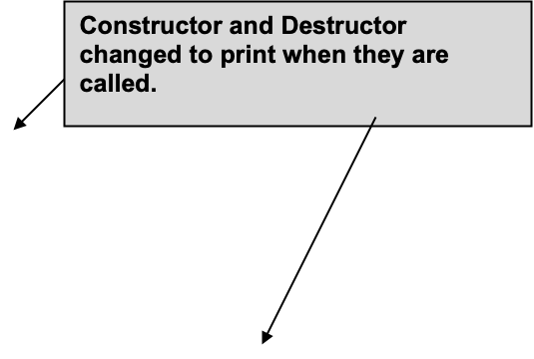
Object Oriented Programming-Spring 23

Slide 22
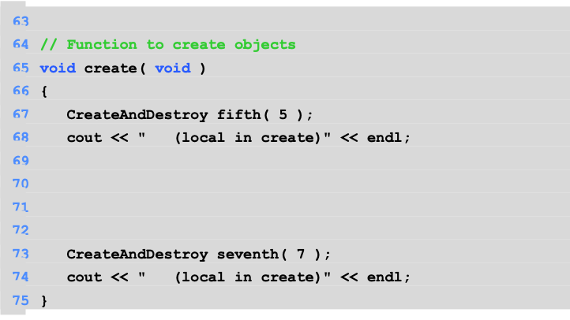
Object Oriented Programming-Spring 23

Slide 23
OUTPUT
Object 1 constructor (global created before main)
Object 2 constructor (local in main)
Object 5 constructor (local in create)
Object 7 constructor (local in create)
Object 7 destructor
Object 5 destructor
Object 4 constructor (local in main)
Object 4 destructor
Object 2 destructor
Object 1 destructor
Notice how the order of the constructor and destructor call depends on the types of variables (local and global) they are associated with.
Object Oriented Programming-Spring 23

Slide 24

Quiz 2
Create a class called Complex for performing arithmetic with complex numbers. Write a program to test your class.
Complex numbers have the form
realPart + imaginaryPart * i
where i is
Use double variables to represent the private data of the class. Provide a constructor that enables an object of this class to be initialized when it is declared. The constructor should contain default values in case no initializers are provided. Provide public member functions that perform the following tasks:
Adding two Complex numbers: The real parts are added together and the imaginary parts are added together.
Subtracting two Complex numbers: The real part of the right operand is subtracted from the real part of the left operand, and the imaginary part of the right operand is subtracted from the imaginary part of the left operand.
Printing Complex numbers in the form (a, b), where a is the real part and b is the imaginary part.

